Slide 1
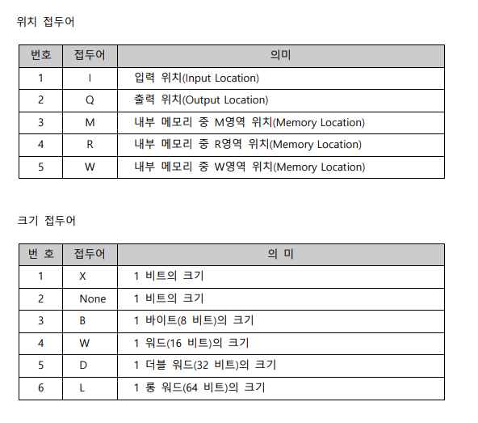
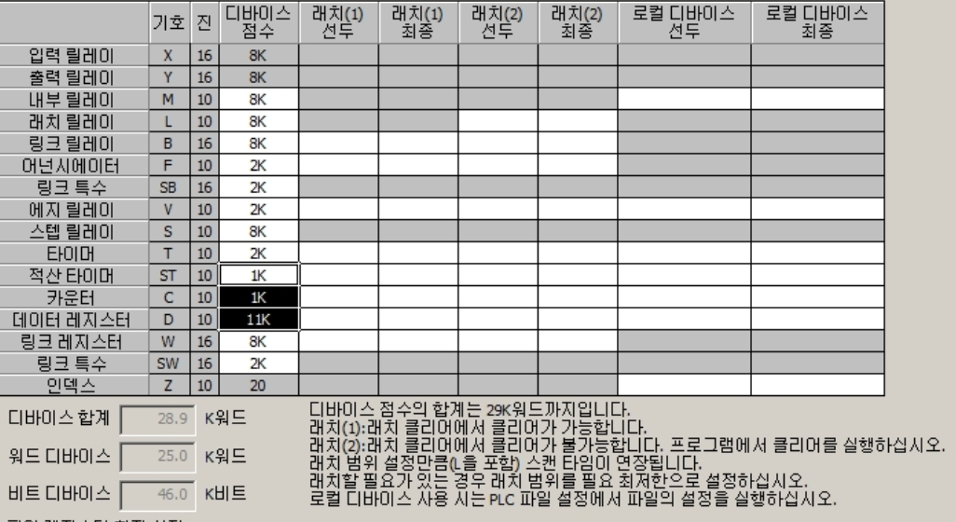
LS XGI
GX Melsec
https://sol.ls-electric.com/uploads/document/16572861196090/XGI%20%EC%B4%88%EA%B8%89_V21_.pdf
https://mmol.tistory.com/151
p29

Slide 2
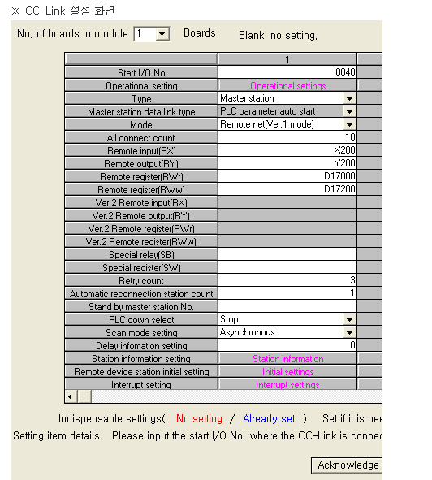
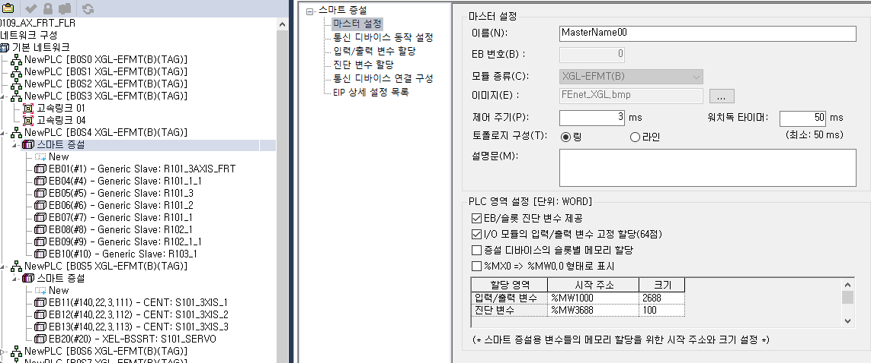
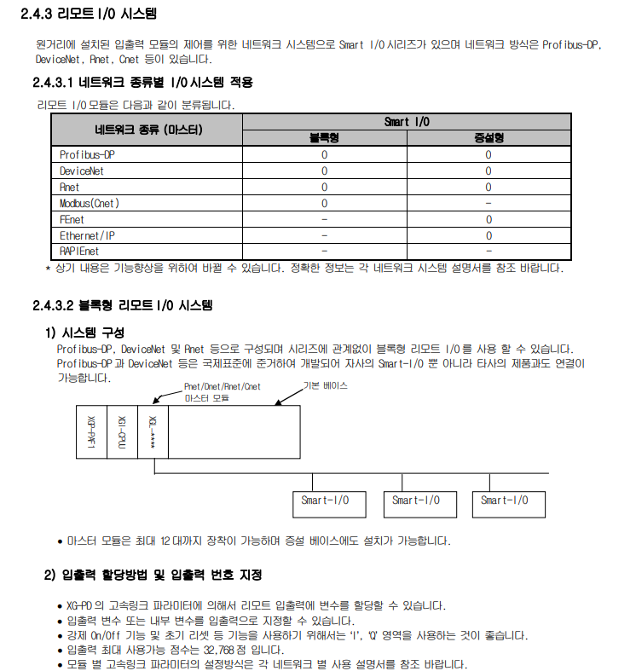
cpu to remote IO
LS XGI
GX Melsec
http://www.famart.co.kr/resource/ls/%EC%82%AC%EC%9A%A9%EC%84%A4%EB%AA%85%EC%84%9C_XGI-CPU_%EA%B5%AD%EB%AC%B8_V2.3.pdf
2-14 page
file:///C:/Users/ahn/Downloads/%EB%AF%B8%EC%AF%94%EB%B9%84%EC%8B%9C_MELSECNET_%EB%9E%98%ED%8D%BC%EB%9F%B0%EC%8A%A4%EB%A9%94%EB%89%B4%EC%96%BC.pdf

Slide 3
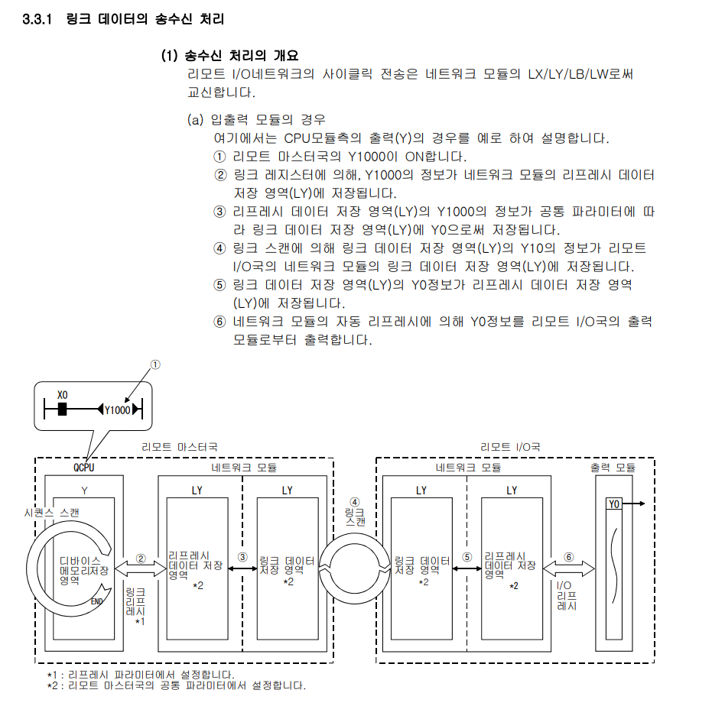
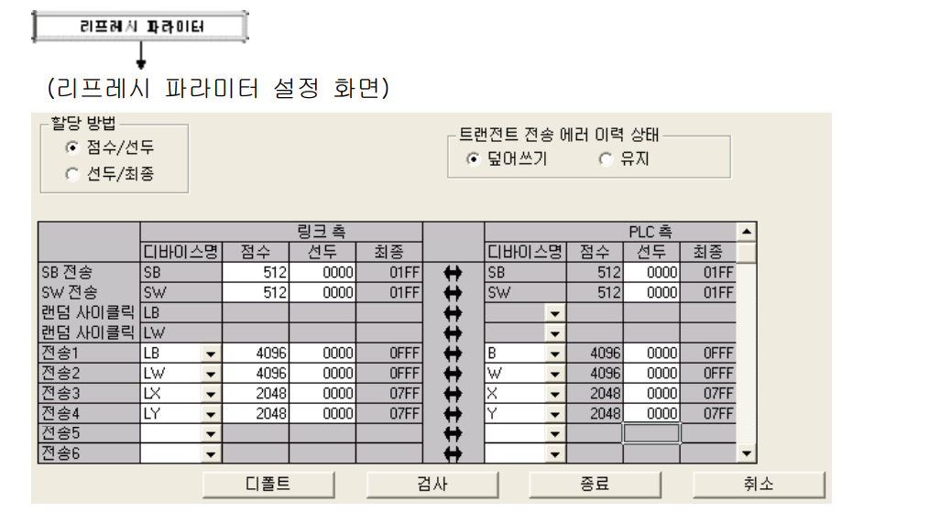
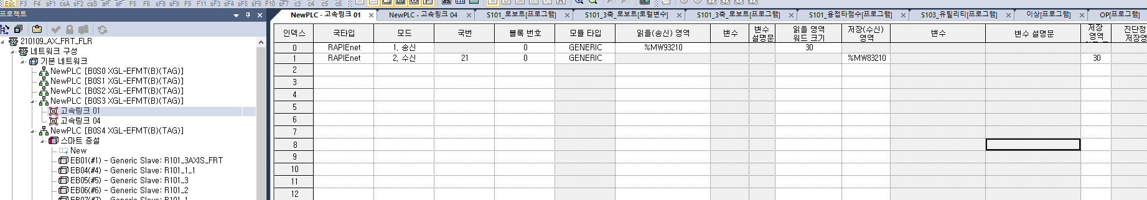
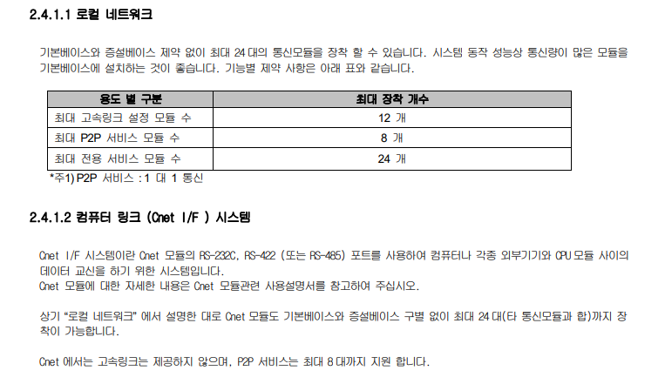
cpu to cpu link
LS XGI
GX Melsec
http://www.famart.co.kr/resource/ls/%EC%82%AC%EC%9A%A9%EC%84%A4%EB%AA%85%EC%84%9C_XGI-CPU_%EA%B5%AD%EB%AC%B8_V2.3.pdf
2-13 page
file:///C:/Users/ahn/Downloads/%EB%AF%B8%EC%AF%94%EB%B9%84%EC%8B%9C_MELSECNET_%EB%9E%98%ED%8D%BC%EB%9F%B0%EC%8A%A4%EB%A9%94%EB%89%B4%EC%96%BC.pdf

Slide 4
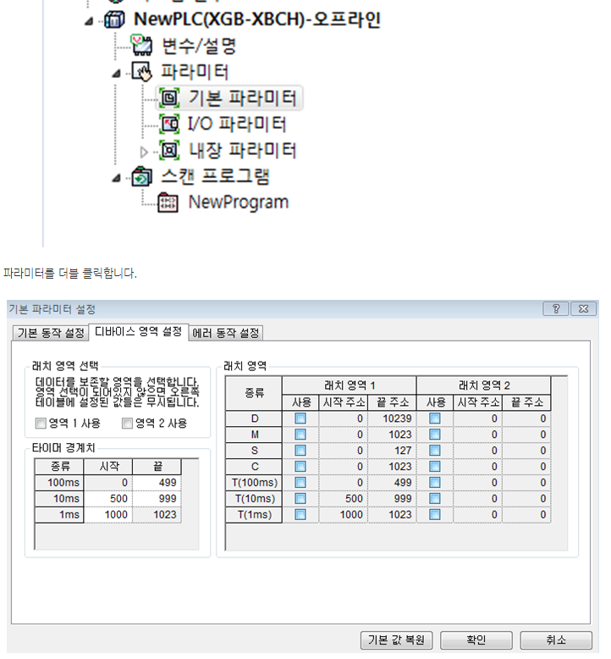
latch 설정
LS XGI
GX Melsec

Slide 5
